Slide 1
Hotel Management System
Name :
1) Shelke Sushma Sunil
SYBCA(under science)
E-Mail : shelkesushma18@gmail.com
2) Shaikh Alfiya Rizwan
SYBCA(under science)
E-Mail : shaikhalfiya193@gmail.com

Slide 3
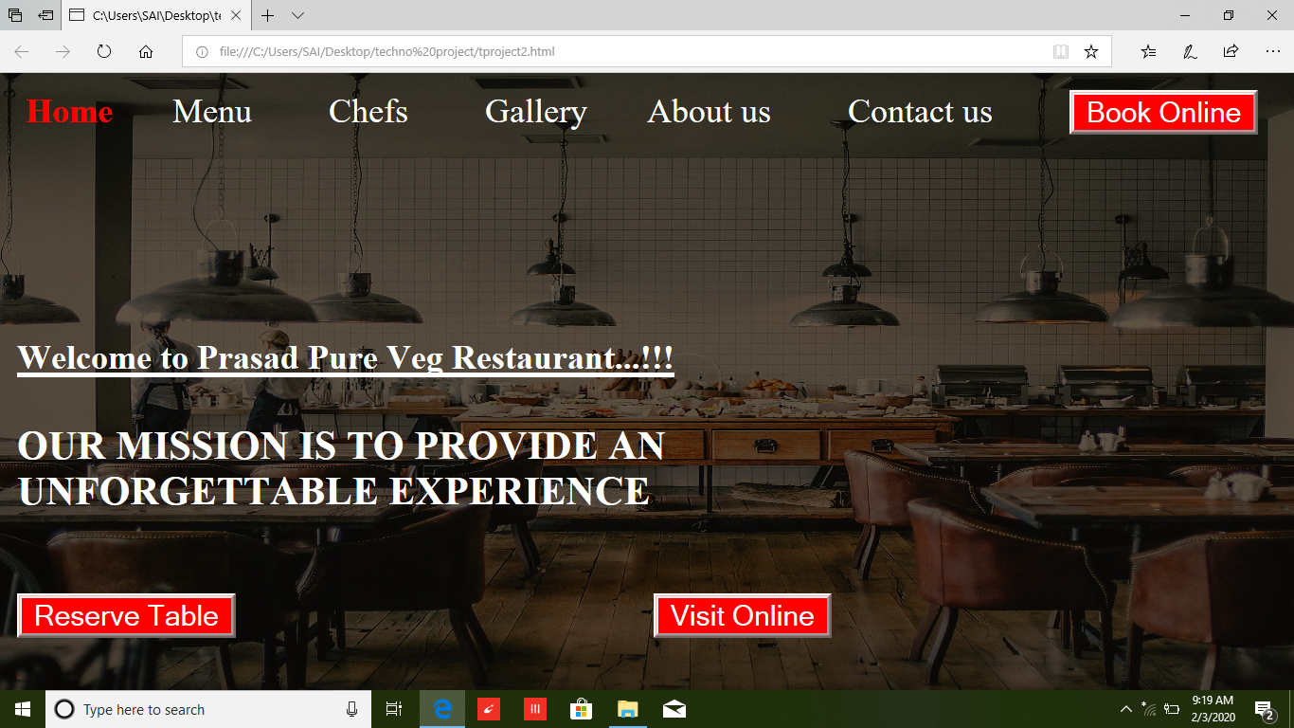
Screenshots :
Home page:

Slide 4
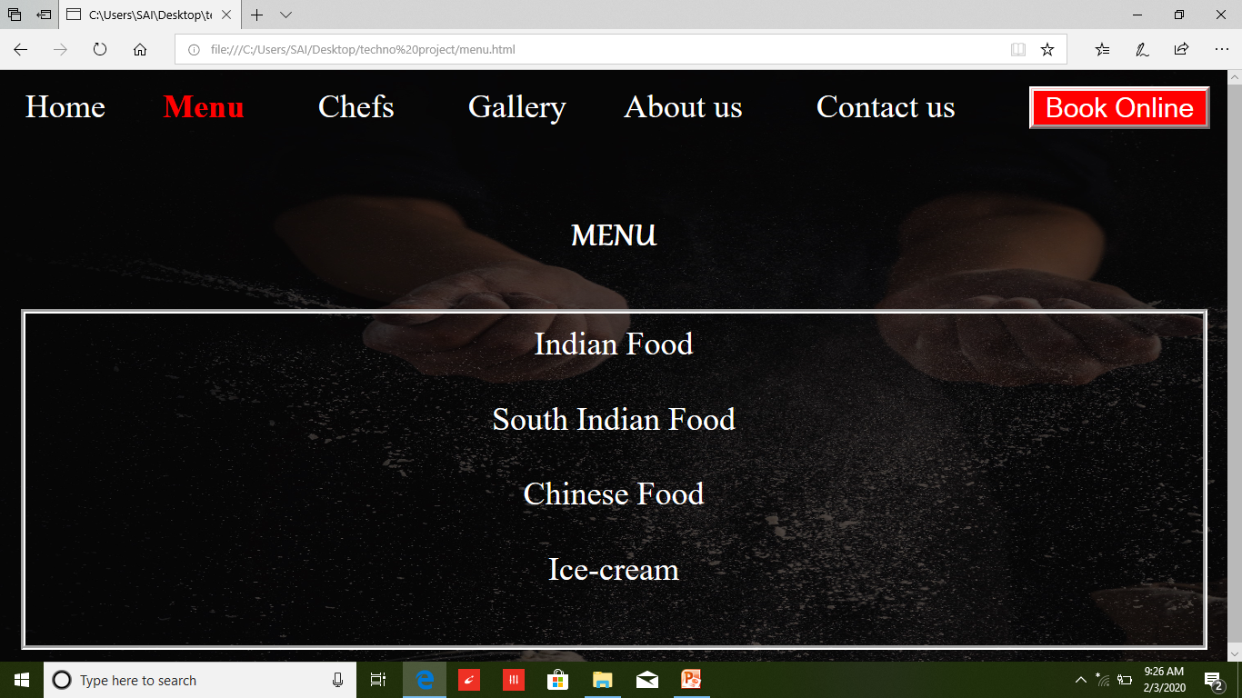
Menu Page :

Slide 5
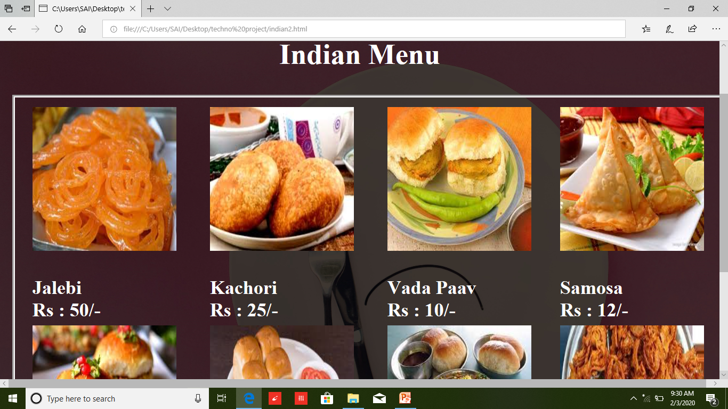
Menu:
Indian Menu

Slide 6
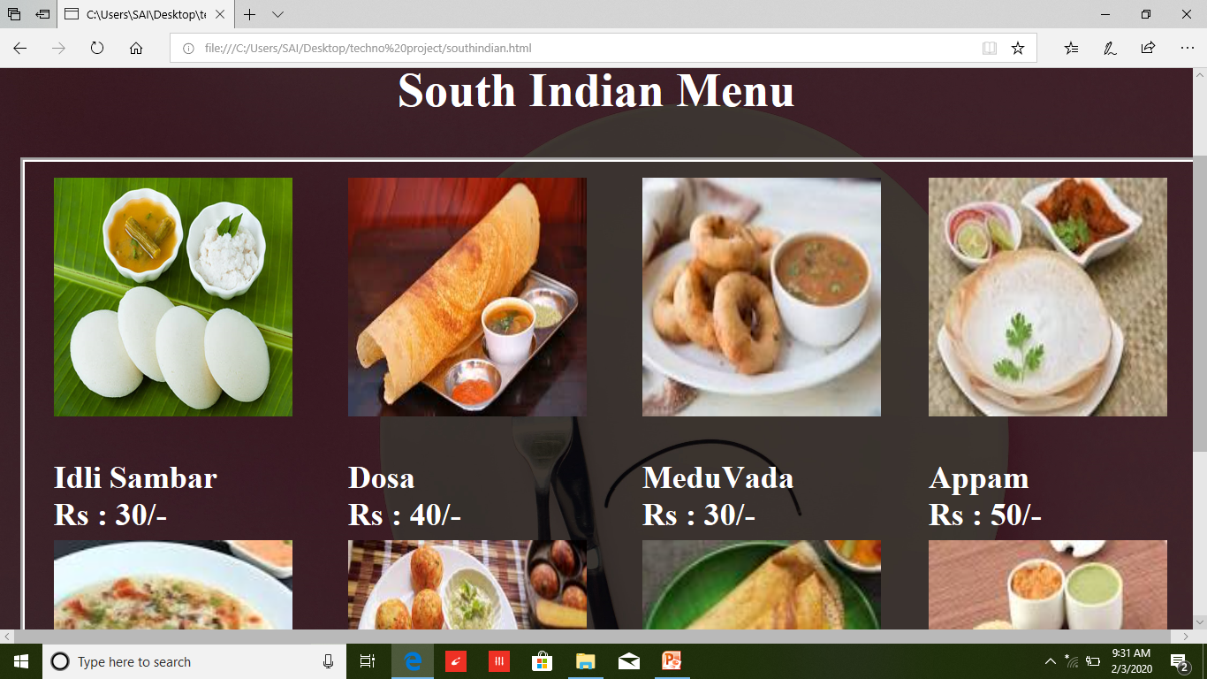
Menu:
South Indian Menu

Slide 7
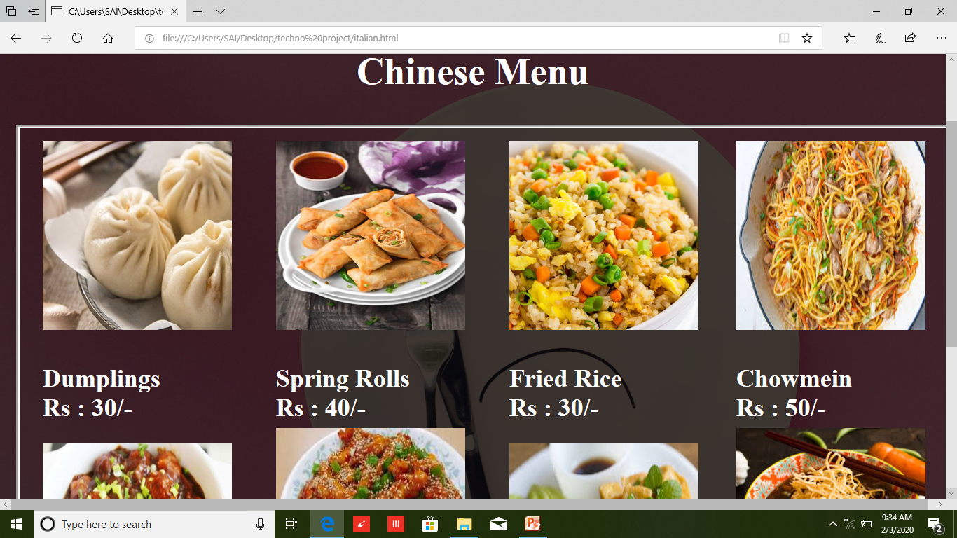
Menu:
Chinese Menu

Slide 8
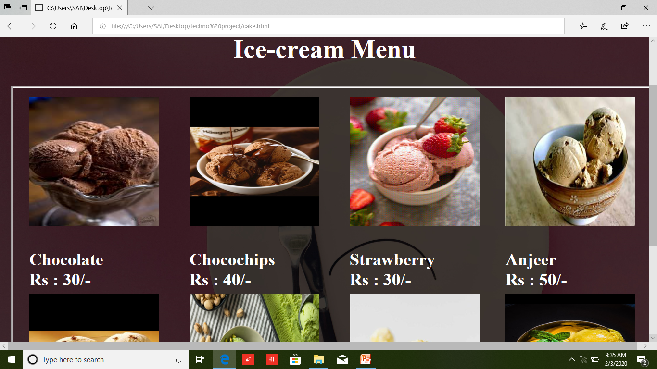
Menu:
Ice-cream Menu

Slide 9
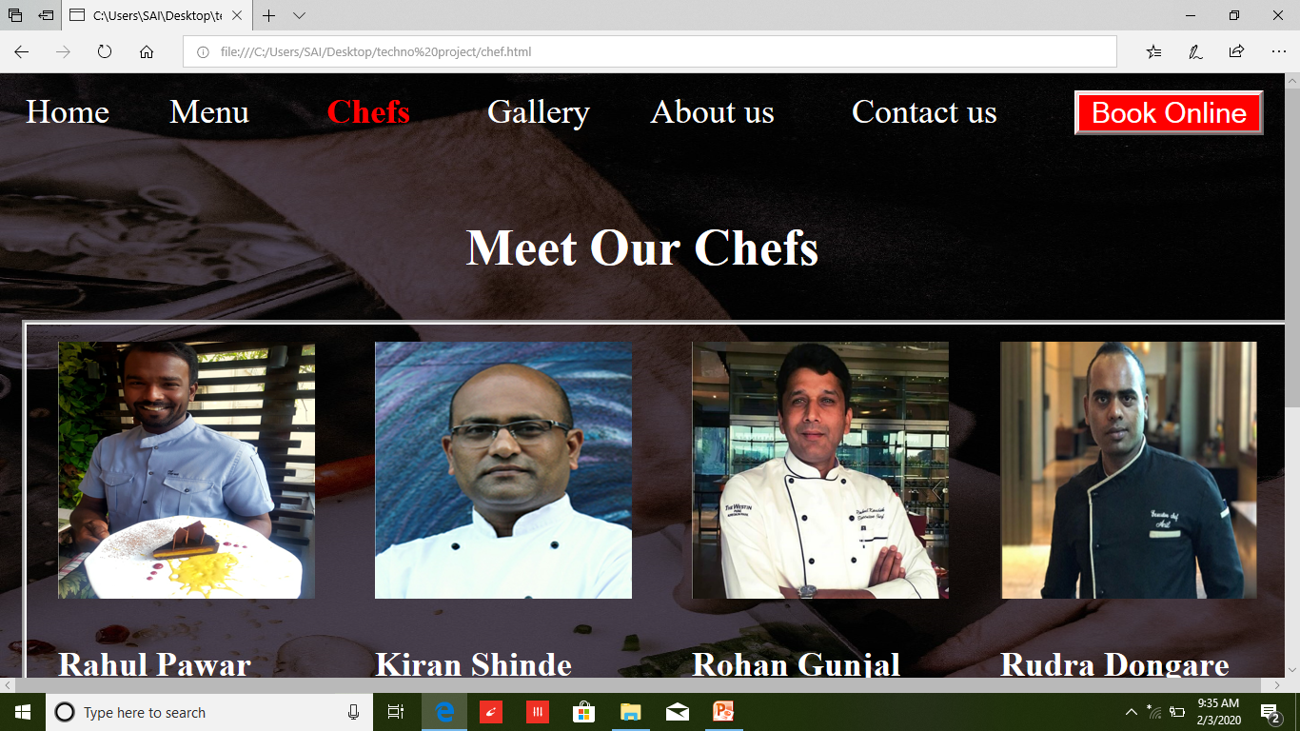
Chefs

Slide 10
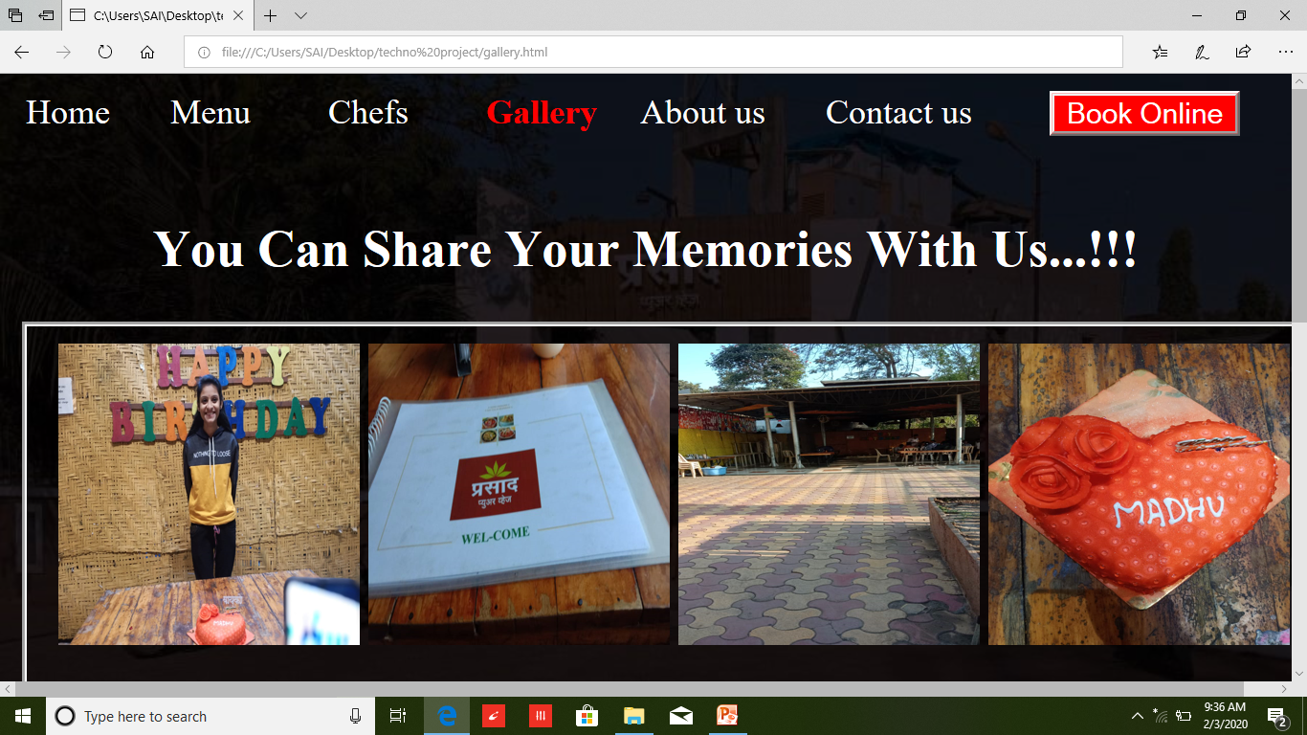
Gallery :

Slide 11
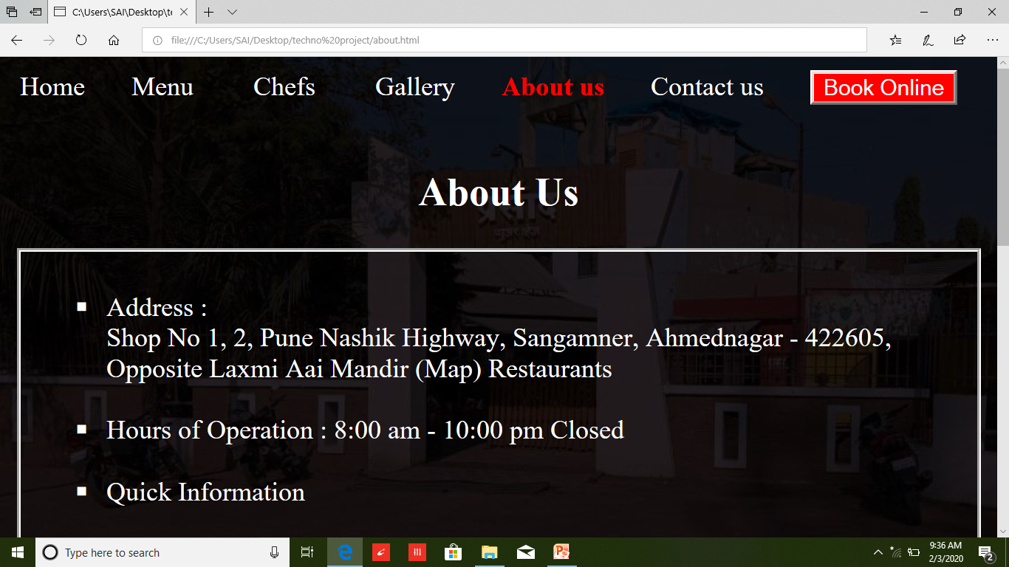
About Us :

Slide 12
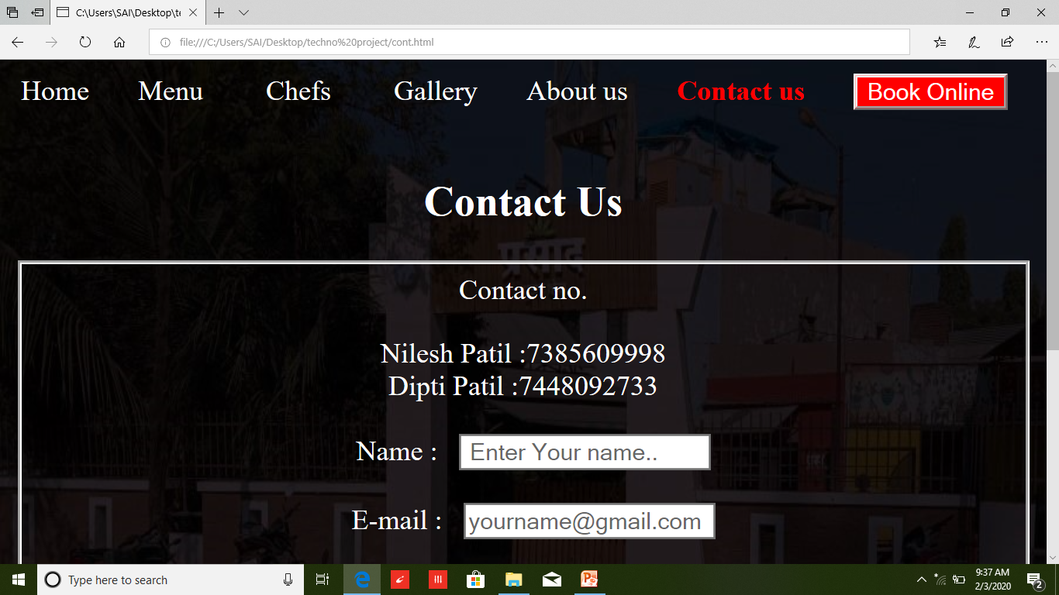
Contact Us :

Slide 13
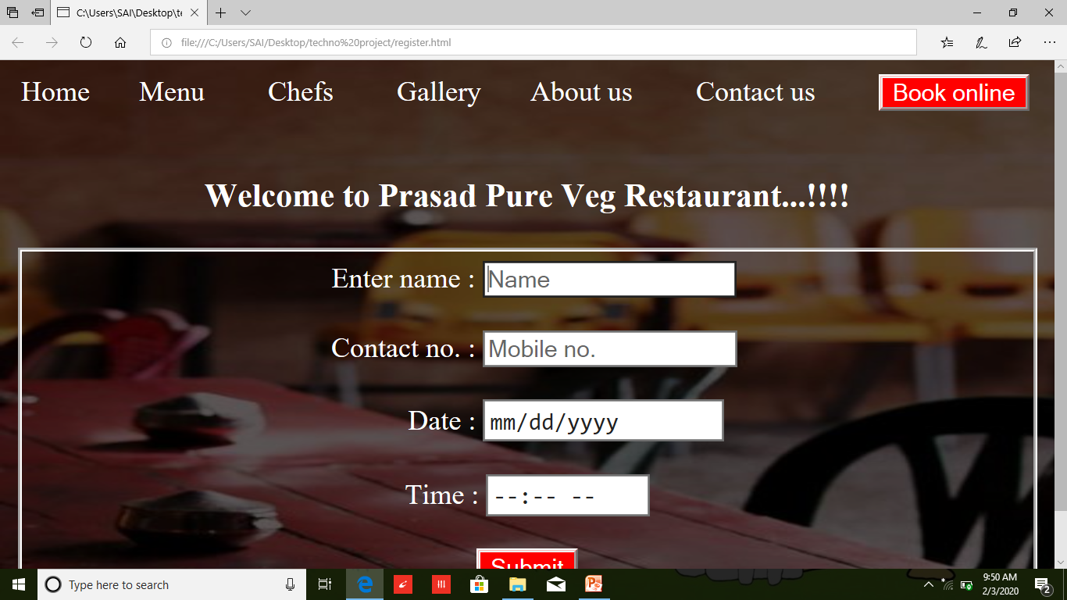
Reserve Table & Book Online Page :

